Slide 1
Firefox IOS
Presented By Rawi & Mariane

Slide 2
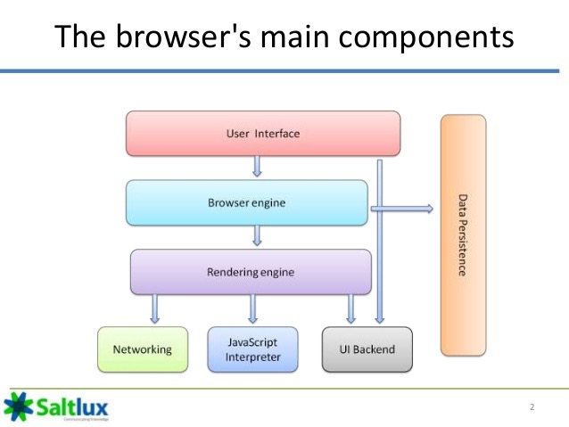
FireFox IOS
What is FireFox IOS?
A browser from Mozilla, for the Apple touch mobile devices.
FireFox IOS did not use the Gecko layout that are used with other FireFox applications
Why did it not use the famous Gecko layout?
Because of Apple's policies, Firefox uses the built-in iOS WebKit-based rendering framework.

Slide 3
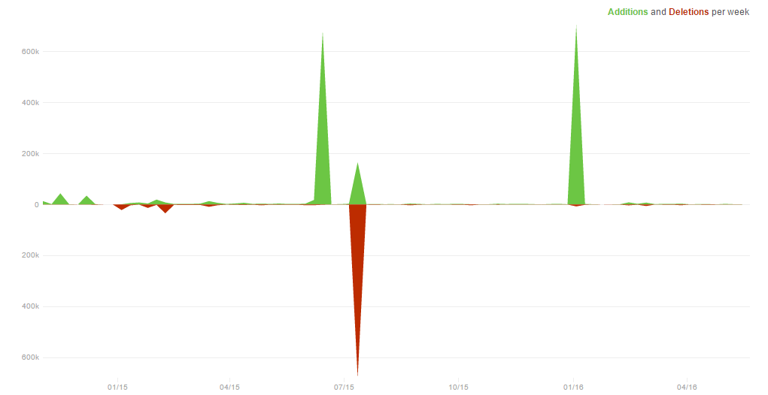
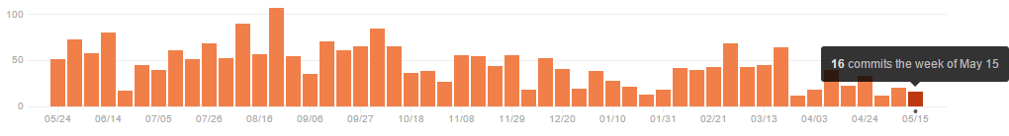
Development & Statistics on Firefox IOS Project
Firefox is an open-source browser, users around the world help to improve it.
Bugzilla: a site where developers can find a list of bugs in Firefox. All developers must follow a swift style to keep the code organized.
Firefox uses the agile method. The goal is to more quickly introduce new features while maintaining backward compatibility, security and overall code quality.

Slide 4
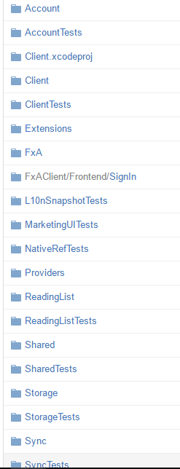
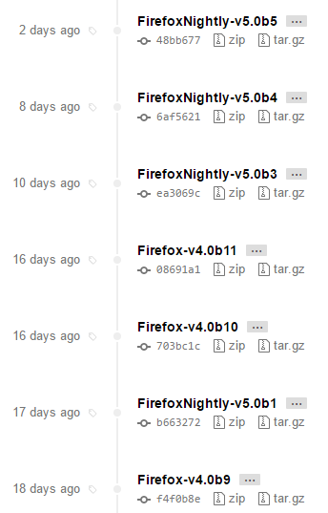
Releases + Code
Firefox separates code to packages to keep everything organized so that it would be easy for developers to add or fix anything.
If developers change they won’t break the functionality of the whole browser.

Slide 5
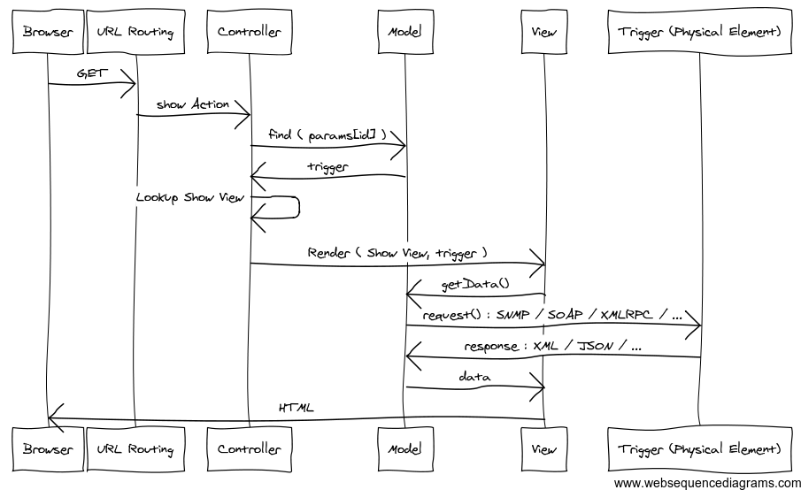
How MVC works in firefox
(UML Diagram)

Slide 6
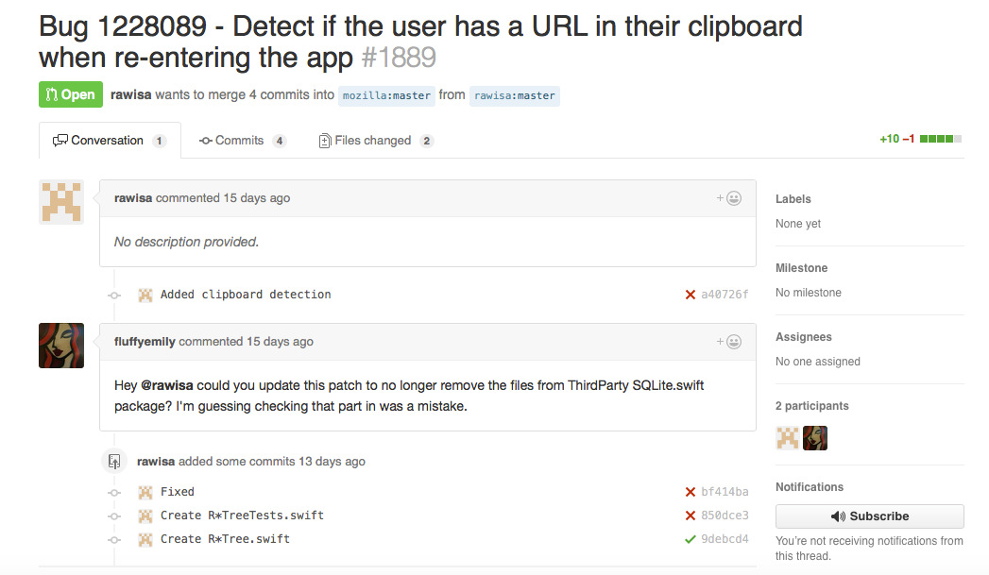
Contribution to firefox IOS

Slide 7


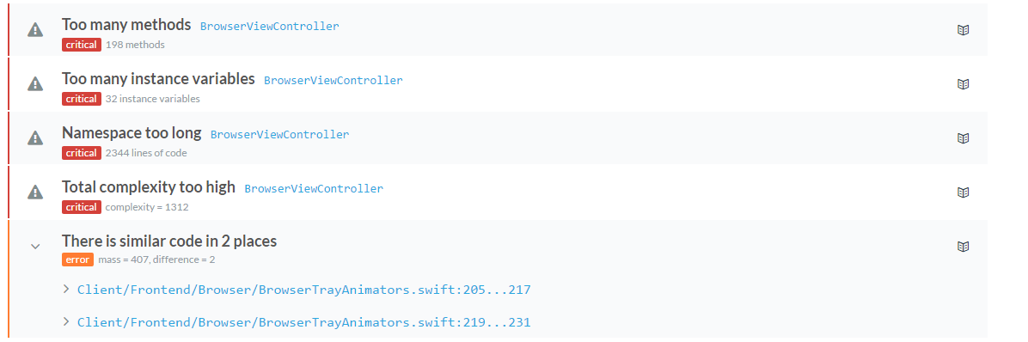
CircleCI helps software teams rapidly release code with confidence by automating the build, test, and deploy process.
Codebeat gathers the results of code analysis into a single, real-time report that gives all project stakeholders the information required to improve code quality.
Firefox has a 3.02 GPA, B grade according to Codebeat

Slide 8

Firefox Sync
Use a strong random secret key, used to encrypt and decrypt all the users’ data. The key is stored alongside the users’ firefox account which means restoring your data is much easier than before even if your device is lost or broken.

Slide 9

Thank you very much,

